Slide 1
Classes and objects
Lecture 5

Slide 2

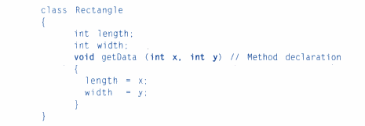
Classes
Defining a class:
Example

Slide 3


Object
Objects in java are created using the new operator
Accessing Class members:

Slide 4
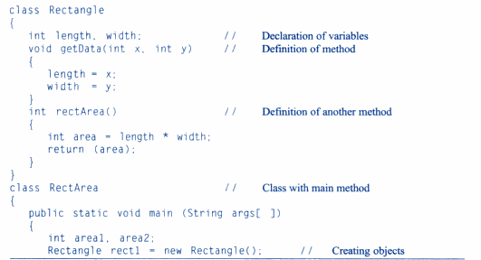
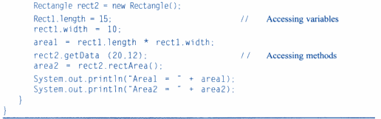
Example

Slide 5
Constructors
Is a special member function that is used to initialize the object.
It is invoked at the time of object creation.
It constructs the value i.e provides data for the object that is why it is known as constructor.

Slide 6
Types
Default Constructor
Parameterized constructor

Slide 7
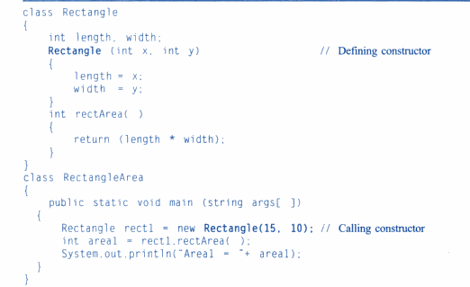

Slide 8
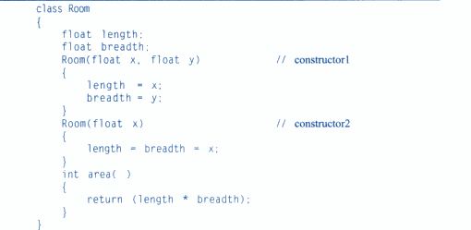
Method Overloading

Slide 9
Static Members
They are the members associated with class and not with objects.. So they are called as class variables and class methods.
Such members can be defined as:
They can only call other static methods.
They can only access static data.
They cannot refer to this or super in any way.

Slide 10
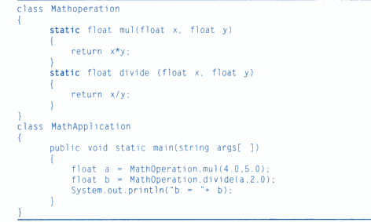
Example

Slide 11
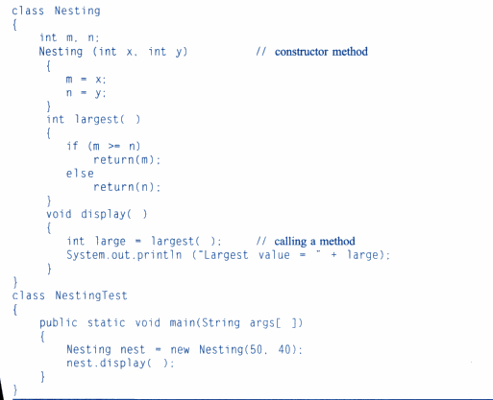
Nesting of Methods

Slide 12
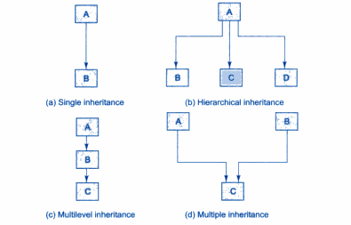
Inheritance
Forms:
Single (only one super class)
Multiple ( Several Super class)
Hierarchical ( one super class, many subclasses)
Multilevel ( derived from a derived class)

Slide 13

Defining a subclass

Slide 14
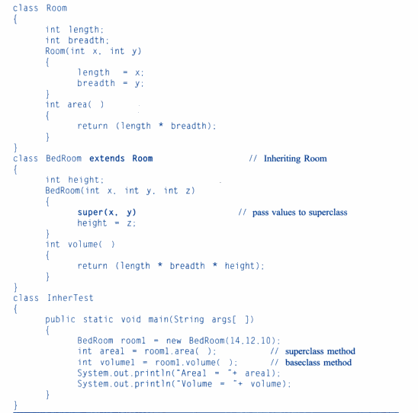

Slide 15
Conditions for constructor
Super may only be used within a subclass constructor method.
The class to super class constructor must appear as the first statement within the subclass constructor.
The parameter in the super call must match the order and type of the instance variable declared in the superclass.

Slide 16

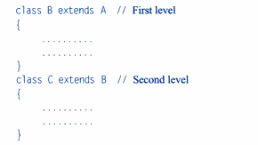
Multilevel inheritance

Slide 17
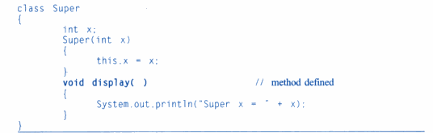
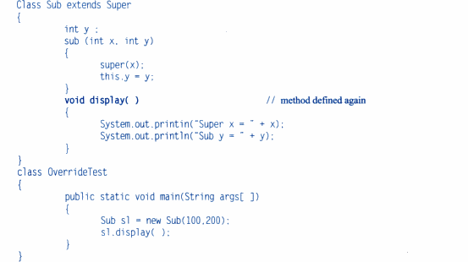
Overriding methods

Slide 18
Final Variables and Methods
In order to prevent the subclasses from overiding the members of the superclass, we can declare them as final using the keyword final as a modifier.
final int size=10;
final void showstatus() {.......}
Making a method final ensures that the functionality defined in this method will never be altered.
The value of the final variable is never changed.
Final variables behave like class variables and they do not take any space on individual objects of the class.

Slide 19
Final Variable Example
class Bike9
{
final int speedlimit=90;//final variable
void run()
{
speedlimit=400;
}
public static void main(String args[])
{
Bike9 obj=new Bike9();
obj.run();
}
}

Slide 20
Java final Method example
class Bike
{
final void run()
{
System.out.println("running");}
}
}
class Honda extends Bike
{
void run()
{
System.out.println("running safely with 100kmph");
}
public static void main(String args[])
{
Honda honda= new Honda();
honda.run();
}
}

Slide 21
Final Method example
class Bike
{
final void run()
{
System.out.println("running...");
}
}
class Honda2 extends Bike
{
public static void main(String args[])
{
new Honda2().run();
}
}

Slide 22
FINAL CLASS
We may like to prevent a class being further subclasses for security reasons.
A class that cannot be subclassed is called a final class.
final class A { ... }

Slide 23
Abstract methods and classes
Abstract method: a method which must always be redefined in a subclass.
Abstract Class: Class having atleast one abstract method.
abstract class Shape
{
.....
abstract void draw();
....
}
We cannot declare abstract constructor.
We cannot use abstract class to instantiate objects directly.

Slide 24
VISIBILITY CONTROL
Access Modifiers:
Public : It is accessible to all classes regardless of their package.
Friendly : it is accessible only to classes in the same package.
Protected : visible to classes and subclasses in same package and subclasses of other package.
Private : accessible within its own class.
Private Protected : visible to all subclasses regardless of the package.

Slide 25
